Slide 1
Day-6 assignment
By
Bhanu rama krishna Prakash jakkamsetti
03/2/20222

Slide 2
agenda :
Bubble sorting
Linear Search
Binary Search

Slide 3
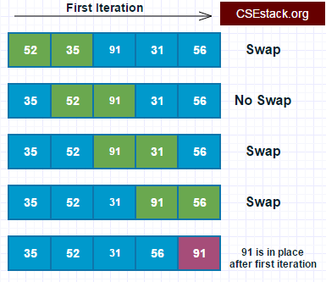
Bubble Sorting :
Bubble sort is a simple sorting algorithm. This sorting algorithm is a comparison-based algorithm in which each pair of adjacent elements is compared and the elements are swapped if they are not in order.
Let’s say our int has 5 elements − int[] arr = { 78, 55, 45, 98, 13 };
Start with the first two elements 78 and 55. 55 is smaller than 78, so swap both of them. Now the list is
55, 78,45,98, 13
55, 45, 78, 98, 3
55, 45, 78, 3, 98
This was the first iteration. After performing all the iterations, we will get our sorted array using Bubble Sort
3, 45, 55, 78, 93

Slide 4
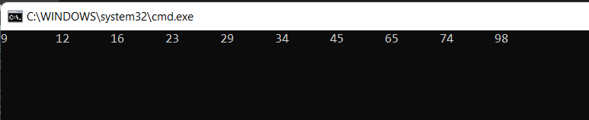
Bubble Sorting Program :
namespace ppt_bubble_sort
{
public class BubbleSrt
{
public static void Main(string[] args)
{
//Array created with 10 unsorted numbers
int[] arr = new int[10] { 23, 98, 45, 12, 9, 16, 65, 74, 34, 29 }; bubblesort(arr, 10);
int a;
for (a = 0; a < 10; a++)
//Printing the array after sorting in descending order
Console.Write(arr[a] + "\t");
Console.ReadLine();
}
//bubble sort
static void bubblesort(int[] data, int n)
{
int a;
int b;
for (a = 0; a < n; a++)
for (b = n - 1; b > a; b--)
//Condition to arrange array ascending order
if (data[b] < data[b - 1])
{
int temp = data[b];
data[b] = data[b - 1];
data[b - 1] = temp;
} } } }
Output :

Slide 5
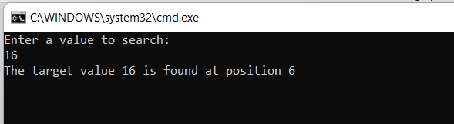
Linear Search Program :
namespace ppt_linear_search
{
internal class Program
{
static void Main(string[] args)
{
Program search = new Program();
int[] search list = new int[] { 3, 5, 12, 5, 28, 16, 20, 35, 9 };
int n, res;
Console.WriteLine("Enter a value to search: ");
n = Convert.ToInt32(Console.ReadLine());
res = search.LinearSearch(search_list, n);
if (res >= 0)
Console.WriteLine("The target value " + n + " is found at position " + res);
else
Console.WriteLine("Target Not Found");
Console.ReadLine();
}
int LinearSearch(int[] arr, int target)
{
for (int i = 0; i < arr.Length; i++)
{
if (target == arr[i])
return (i + 1);
}
return -1;
Console.ReadLine(); } } }
Output :

Slide 6

Linear search :
Traverse the array using a for loop.
In every iteration, compare the target value with the current value of the array. If the values match, return the current index of the array. If the values do not match, move on to the next array element.

Slide 7
Linear Search Program :
namespace ppt_linear_search
{
internal class Program
{
static void Main(string[] args)
{
Program search = new Program();
int[] search list = new int[] { 3, 5, 12, 5, 28, 16, 20, 35, 9 };
int n, res;
Console.WriteLine("Enter a value to search: ");
n = Convert.ToInt32(Console.ReadLine());
res = search.LinearSearch(search_list, n);
if (res >= 0)
Console.WriteLine("The target value " + n + " is found at position " + res);
else
Console.WriteLine("Target Not Found");
Console.ReadLine();
}
int LinearSearch(int[] arr, int target)
{
for (int i = 0; i < arr.Length; i++)
{
if (target == arr[i])
return (i + 1);
}
return -1;
Console.ReadLine(); } } }
Output :

Slide 8
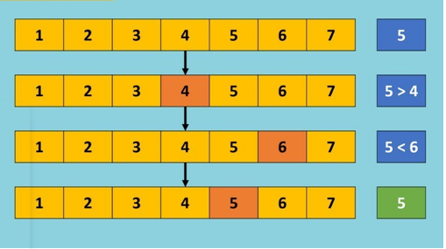
Binary Search :
Binary search works on a sorted array. The value is compared with the middle element of the array. If equality is not found, then the half part is eliminated in which the value is not there. In the same way, the other half part is searched.
Here is the mid element in our array. Let’s say we need to find 62, then the left part would be eliminated and the right part is then searched

Slide 9
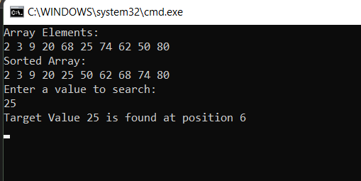
Binary Search Program :
int search_value(int[] arr, int target)
{
int low, high, mid;
low = 0;
high = arr.Length - 1;
mid = (low + high) / 2;
while (low <= high)
{
if (arr[mid] == target)
return mid + 1;
else
if (target < arr[mid])
high = mid - 1;
else
low = mid + 1;
mid = (low + high) / 2;
}
return -1;
Console.ReadLine();
} } }
namespace ppt_binary_search
{
internal class Program
{
internal class BSearch
{
static void Main(string[] args)
{
BSearch search = new BSearch();
int[] search_list = new int[] { 2, 3, 9, 20, 68, 25, 74, 62, 50, 80 };
int b, res;
Console.WriteLine("Array Elements: ");
foreach (int i in search_list)
Console.Write(i + " ");
Console.WriteLine();
Array.Sort(search_list);
Console.WriteLine("Sorted Array: ");
foreach (int i in search_list)
Console.Write(i + " ");
Console.WriteLine();
Console.WriteLine("Enter a value to search: ");
b = Convert.ToInt32(Console.ReadLine());
res = search.search_value(search_list, b);
if (res > 0)
Console.WriteLine("Target Value " + b + " is found at position " + (res + 1));
else
Console.WriteLine("Target bot found!");
Console.ReadLine();
}
Output :

Slide 10


